Slide 1
Name:
Instructor:
Course:
Date:

Slide 2
HUMAN EVOLUTION: An Introduction
Human evolution refers to the process by which human beings evolved from their ape ancestors.
Scientific research and evidence shows that for a period of about 6 million years, man developed behavioral and physical features similar to those of apes.
The evolution history is marked with the development of the homo and specifically, the Homo sapiens (M'charek 543).
The preceding Homo species had remarkably developed characteristics that differentiated them from apes, including bipedalism, language, and interbreeding among other hominins.

Slide 3
PALEOANTHROPOLOGY
The study of human evolution is referred to as paleoanthropology.
Paleoanthropology as a scientific study of human evolution includes various studies of biology, anthropology, culture, and society.
The study is based on studying and understanding the similarities and differences between humans and other animals in their species in terms of body structure, physiology, biological processes, and behavior.
Although Paleoanthropology is a very exciting science about human evolution, it is not well accepted among other people due to its conflicting stance with religion.

Slide 4
CHANGES IF HUMAN ANATOMY
The evolution of human beings from its ape-like ancestors, especially the Chimpanzees, is marked with a number of anatomical changes in humans:
Larger brain size
Bipedalism
Lengthy gestational and infancy periods
Reduced changes in male vs. female physique
Development of language

Slide 5
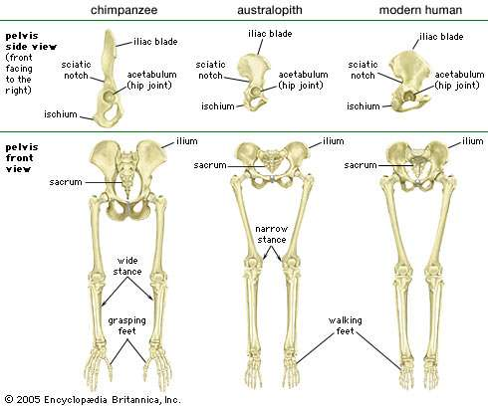
Pelvic Changes
Source: Cameron 276

Slide 6
Larger Brain Size
The development of a larger brain size among human beings is referred to as encephalization.
Man developed a larger brain compared to other primates. The human brain is estimated to be three times larger than that of the gorilla or chimpanzee.
After the Australopithecus, the preceding stage, the Homo Abilis had a larger brain size and the process continued with the Homo erectus and peaked with the Neanderthals.
Encephalization allowed for human beings to increase their ability for language learning and other forms of social learning.

Slide 7
Bipedalism
Bipedalism was the significant development that distinguished human beings from other apes.
The earlierst bipedal ape was the Orrorin, and other non-bipedal walkers like the gorilla and chapanzee are belieived to have evolved from the Orrorin.
Bipedalism developed in the early humans as an adaptation mechanism for grasping, long distance running and hunting, reaching the top of trees for fruits, enhanced vision, and reducing man’s exposure to the sun.

Slide 8
Physical Changes to Support Bipedalism
As noted earlier, bipedalism was perhaps the greatest physical development in the evolution of man. To enable the new position, the human skeleton underwent the following changes:
  The femur took an angular position to move the body’s center of gravity to the center for more stability.
  Ankle joints and the knees became stronger and more flexible to enable walking.
  The vertebral column took an S-shape due to increased weight on the vertebrae.
  The big toe realigned itself for better locomotion going forward.
  The arms shortened for better balance.
  The pelvis shortened and birth canal reduced in size.

Slide 9
LENGTHY GESTATIONAL AND INFANCY PERIODS
Early human beings increased the period of their gestation compared to other primates to enable full development of the complex human system.
The development of social skills and protected homes for the early man required longer periods of infancy whereby the mother would protect the baby from predators.

Slide 10
REDUCED CHANGES IN MALE VS. FEMALE PHYSIQUE
Compared to other male primates, the human male is smaller in size and other physical features such as:
  Reduced canine teeth
  Smaller ridges of the brow
  Generally smaller body size
  Body hair and subcutaneous fat are of almost same size between male and female humans.
  The smaller human male size is referred to as sex dimorphism.
  The reason for sex dimorphism in humans is so as to allow for bonding between the male and female human for sex activities and parental requirement.

Slide 11
EVIDENCE FOR EVOLUTION
Evidence for the evolution process lies in fossils and other archeological artifacts that have been discovered in various parts of the world.
Some of the remains include skulls, bones, footprints, hearths, and early knives among others.
The remains were buried and thus, preserved by natural processes such as earthquakes and then exposed by natural processes as well such as soil erosion (Ramachandran et al… 184).
Archeologists study these pieces of evidence to provide more information and ascertain to the process of human evolution.

Slide 12
THE PROCESS OF EVOLUTION
The process of human evolution was first coined by Charles Darwin, who argued that human beings were linked in some way to other earlier primates.
The proposition for human evolution was supported by findings of earlier human skulls in various parts of the world (Cameron 234). By studying similarities and differences in the skulls, researchers were able to prove that man evolved through a number of processes to become the modern man he is.

Slide 13
Genetic Evolution
Genetic evolution was discovered through testing of blood serum between pairs of animals, including humans and other primates.
The testes established the immunological differences between man and apes and placed it to have been between 4-5 million years ago.
Generational mutations are believed to have been the cause of differences between humans and their ape ancestors.
New human genes, however, are believed to have been cross-bred through interbreeding between proto-chimps and proto-humans, thus causing major changes in the new gene pools.

Slide 14
Genetic Evolution: DNA
In the real sense, evolution is said to occur when an organism’s genetic material undergoes change. Change in DNA is manly due to gene mutation, which refers to the way that genes are organized and their composition and how they influence different human processes and behaviors.
The process of evolution is believed to have been as a result of these changes in genes. The changed genes were passed on to the offspring and eventually, the entire population became different from the previous generation.

Slide 15
Human Dispersal
Early humans are believed to have lived in Africa. However, the genus Homo migrated out of the continent due to climate changes. It is these immigrations to other parts of the world that are believed to have led to the dispersal of humans into all parts of the world.
The Southern Dispersal Theory is used to explain the process of early human immigration.
According to this theory, early humans left Africa through the Horn of Africa across the Ocean to Asia.
Other theories of early human immigration all support the theory that early man left Africa through various routes and for reasons of climate change and exploration to reach other worlds.

Slide 16
TOOLS
The evolution of human beings could not be complete without understand the tools that enabled their evolution.
The adoption and use of tools is also viewed as a sign of human intelligence and could have led to human evolution as well, especially the evolution of the human brains (Hoagland 113).
The enlarging of the human brain meant that early man required more energy producing foods to power it. This could explain what man developed better tools to enable hunting for meat and other foods.
On the other hand, one can say that the evolution and enlargement of human brain gave man new ideas for better survival like tool making.

Slide 17
STONE TOOLS
These are the earliest tools that man developed.
Early man would splint smaller stones that were sharp on the edges and use them as choppers (Boyd 45).
In later stages of its development, early man learnt to make tools such as axes, needles, and slicers.
Improvements to the art of making stone tools were done during the early, middle, and late stone age as well as the much later Acheulean stages. Acheulean stage of stone making saw early man develop stone tools that were more refined and customized to specific use.

Slide 18
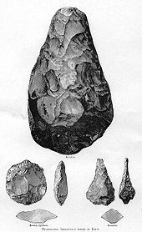
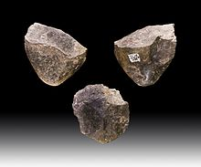
Stone Tools by Early Man
(Source Cameron 121)

Slide 19
EVOLUTION FROM PRIMITIVE TO MODERN BEHAVOR
It is believed that early humans continued to use stone tools until 40-50,000 years ago.
After this period, humans began improving their behaviorals mechanisms a lot faster than before.
Social practices developed among humans such as living in a community and burying their dead. Forms of at such as painting, drawing, and language developed over 75,000 years ago.
Ever since, human behavior continues to evolve toward modernity as man continues to develop even more sophisticated tools through technology.

Slide 20
REFERENCES
Boyd, Robert and Silk, Joan. How Humans Evolved (3rd ed.). New York: Norton. 2003. Print.
Cameron, David. Hominid Adaptations and Extinctions. Sydney, NSW: UNSW Press. 2004. Print.
Hoagland, Hudson. Science and the New Humanism. Science, 143 (3602): 111–114. 1964. Print.
M'charek, Amade. The Human Genome Diversity Project: An Ethnography of Scientific Practice. Cambridge Studies in Society and the Life Sciences. Cambridge; New York. 2005. Print.
Ramachandran, Sohini., Hua, Tang., Gutenkunst, Ryan N., and Bustamante, Carlos. Genetics and Genomics of Human Population Structure. Heidelberg; London; New York: Springe. 2010. Print

